Slide 1

SEMINAR INFORMATION SYSTEMS
Big Peer Reviews
12.12.2019
Melike Merdan
Asena Ciloglu

Slide 2
01
TABLE OF CONTENTS
02
03
04
INTRODUCTION
About Peer Reviews & Conferences
DESCRIPTIVE ANALYTICS
Data & Insights
APPLICATION
Methodology & Models
RESULTS
Results & Future Research

Slide 3
01
INTRODUCTION
Peer Review & Conferences

Slide 4

01
THE COMPANY
WHAT IS PEER REVIEW?
This is the subtitle that makes it comprehensible
Flickr AJ Cann, CC BY SA
Notes:
Why peer review matters:
Peer review has been a formal part of scientific communication since the first scientific journals appeared more than 300 years ago. The Philosophical Transactions of the Royal Society is thought to be the first journal to formalize the peer review process under the editorship of Henry Oldenburg (1618- 1677).
Despite many criticisms about the integrity of peer review, the majority of the research community, including the prestigious scientific venues, still believes peer review is the best form of scientific evaluation. [3]

Slide 5
WHAT IS OUR MOTIVATION?
Determinant of scientific evaluation
Limited access
Consistency, bias, author response and general review quality
Self-regulatory nature of the world of science and research
Notes:
Quantitative studies of peer reviews had been limited, to the few individuals who had access to peer reviews of a given venue[1]
Prestigious scientific venues use peer reviewing to decide which papers to include in their journals or proceedings.[1]
it is often a subject of debate. Recognizing the important consequences of peer reviewing, several researchers studied various aspects of the process, including consistency, bias, author response and general review quality [1]
Reviewers are generally not paid for their time since peer review is simply considered to be part of the self-regulatory nature of the world of science and research.
ACL 2017 = double blind
ICLR 2017 = single blind, 2018/2019 double blind
CoNLL 2016 = double blind
NIPS = double blind

Slide 6
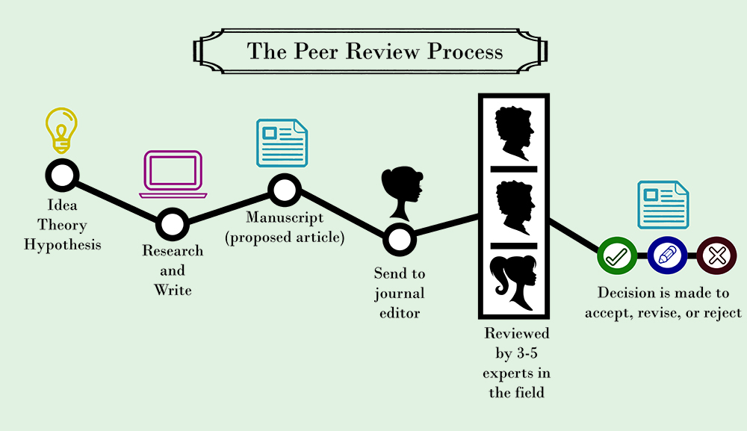
WHOA!
It could be the part of the presentation where you can introduce yourself, write your email…
https://s3.amazonaws.com/libapps/accounts/16993/images/PeerReviewProcess1.jpg

Slide 7




CONFERENCES
Association of Computational Linguistics
Conference on Computational Natural Language Learning
International Conference on Learning Representations
Conference on Neural Information Processing Systems

Slide 8
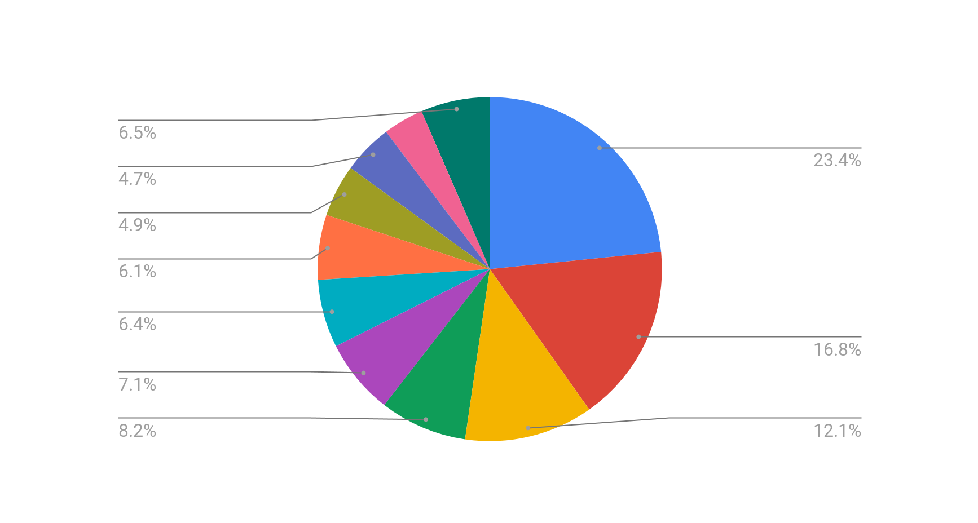
ASSOCIATION OF COMPUTATIONAL LINGUISTICS
Since 1962
The primary forum for research on computational linguistics and natural language processing
Notes:
ACL has a large number of Special Interest Groups (SIGs), focusing on specific areas of natural language processing
such as NLP for Slavic Languages and Chinese
Information Extraction, Retrieval, Question Answering & NLP Applications
Semantics
Generation & Summarization
Machine Translation
Machine Learning
Sentiment Analysis & Opinion Mining
Tagging, Chunking, Syntax & Parsing
Social Media
Dialogue & Interactive Systems
Discourse & Pragmatics

Slide 9
CONFERENCE ON COMPUTATIONAL NATURAL LANGUAGE LEARNING
Since 1997
Top tier conference
Organized by ACL's Special Interest Group on Natural Language Learning

Slide 10
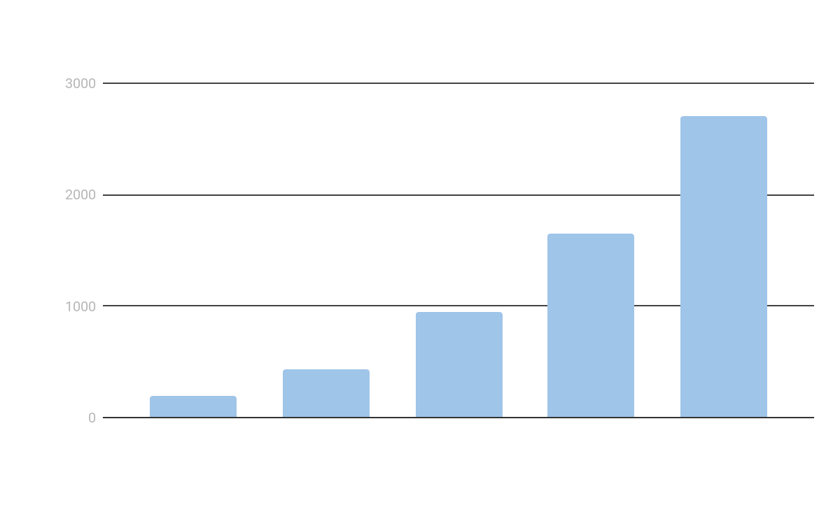
INTERNATIONAL CONFERENCE ON LEARNING REPRESENTATIONS
Since 2013
Research on all aspects of deep learning
Notes:
ICLR is globally renowned for presenting and publishing cutting-edge research on all aspects of deep learning used in the fields of artificial intelligence, statistics and data science, as well as important application areas such as machine vision, computational biology, speech recognition, text understanding, gaming, and robotics.

Slide 11
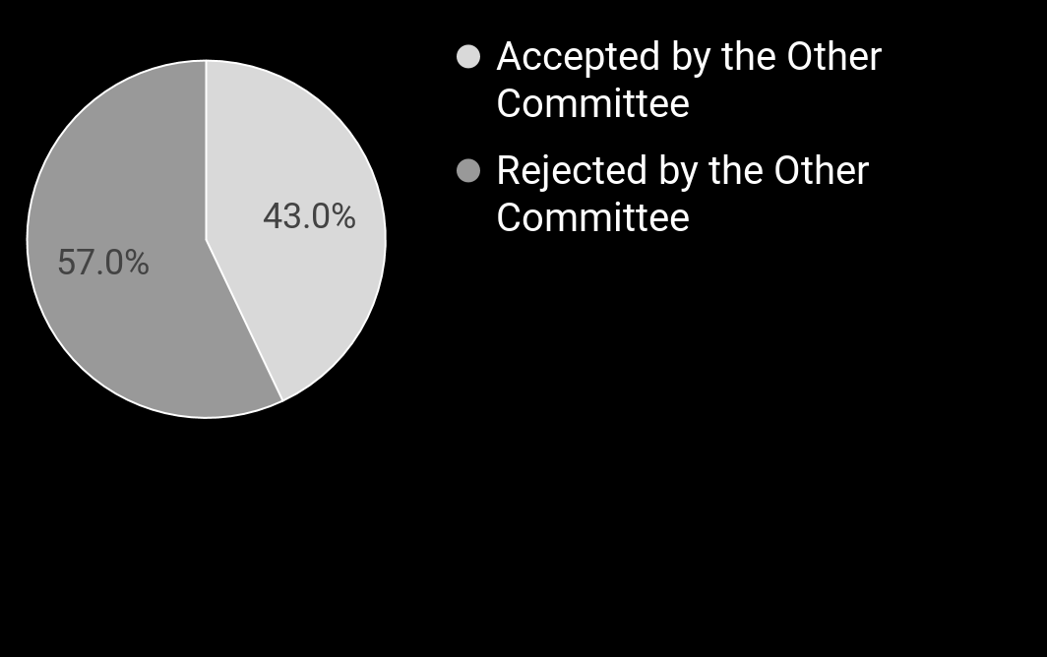
CONFERENCE ON NEURAL INFORMATION PROCESSING SYSTEMS
NIPS Experiment
Since 1987
The largest conference in AI
NIPS Experiment (2014)
Notes:
The two committees were each tasked with a 22.5% acceptance rate. This would mean choosing about 37 or 38 of the 166 papers to accept¹. Since they disagreed on 43 papers total, this means one committee accepted 21 papers that the other committee rejected and the other committee accepted 22 papers the first rejected, for 21 + 22 = 43 total papers with different outcomes. Since they accepted 37 or 38 papers, this means they disagreed on 21/37 or 22/38 ≈ 57% of the list of accepted papers.

Slide 12

arXiv
Open access to 1,628,829 e-prints
Owned and operated by Cornell University
Not specific to Machine Learning but open to all fields
Notes:
Open access to 1,628,829 e-prints in the fields of physics, mathematics, computer science, quantitative biology, quantitative finance, statistics, electrical engineering and systems science, and economics.
No reviews but a labeled set of submissions in 2007–2017 with respect to a group of top-tier NLP, ML and AI venues: ACL, EMNLP, NAACL, EACL, TACL, NIPS, ICML, ICLR and AAAI.
(For consistency, we only include the first arXiv version of each paper (accepted or rejected) in the dataset.)

Slide 13
02
DATA ANALYTICS
Data & Insights

Slide 14
A Dataset of
Peer Reviews:
PeerRead
Paper based on the publicly available dataset creation
Basic predictions on the dataset:
Acceptance classification based on the paper drafts
Aspect score prediction based on the reviews
✓
✓
Notes:
Aspects: : ‘impact’, ‘substance’, ‘appropriateness’, ‘comparison’, ‘soundness’, ‘originality’ and ‘clarity’.
However, some parts of them needed to be crawled due to license issues (nips)
Collection of the reviews:
- Opted-in reviews from ACL 2017 and CoNLL 2016
- Publicly available NIPS reviews from 2013 onwards
- OpenReview platform for ICLR 2017 reviews [2]
Classification task:
Models used:
logistic regression, SVM with linear or RBF kernels, Random Forest, Nearest Neighbors, Decision Tree, Multilayer Perceptron, AdaBoost, and Naive Bayes. They did not use neural models, because they are hard to interpret.
Prediction task:
Three methods:(i) the paper text only, (ii) the review text only, or (iii) both paper and review text.
Models used: CNN, RNN (LSTM), Deep Averaging Networks (DAN), Dictionary: GLOVE

Slide 15
DATASETS
 | # of papers | Reviews | Accepted / Rejected
ACL 2017 | 137 | ✓ | 99 / 38
ICLR 2017 | 427 | ✓ | 172 / 255
CoNLL 2016 | 22 | ✓ | 11 / 11
NIPS 2014-2016 | 1,382 | ✓ | 1,382 / 0
arXiv 2007-2017 | 11,778 | ✕ | 2,891 / 8,887

Slide 16
 | # of papers | Reviews | Accepted / Rejected
ACL 2017 | 137 | ✓ | 99 / 38
ICLR 2017 | 427 | ✓ | 172 / 255
CoNLL 2016 | 22 | ✓ | 11 / 11
NIPS 2014-2016 | 1,382 | ✓ | 1,382 / 0
arXiv 2007-2017 | 11,778 | ✕ | 2,891 / 8,887

Slide 17
DATA CLEANING
Punctuation
Abstract 945 words
Lower Case
Abstract 638 words
Reviews 2095 words
Reviews 1350 words
Stemming
Stopwords
Custom Cleaning
Notes:
STEMMING
Custom cleaning = usually specific to machine learning etc

Slide 18
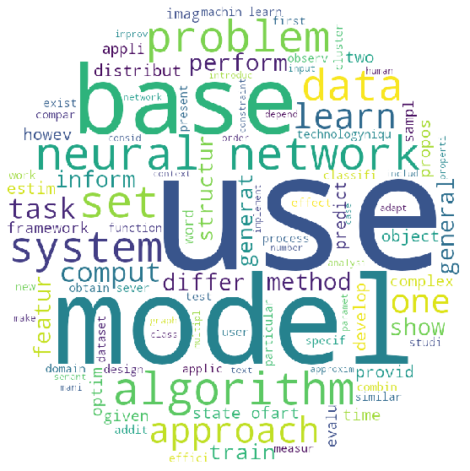
ABSTRACT

Slide 19
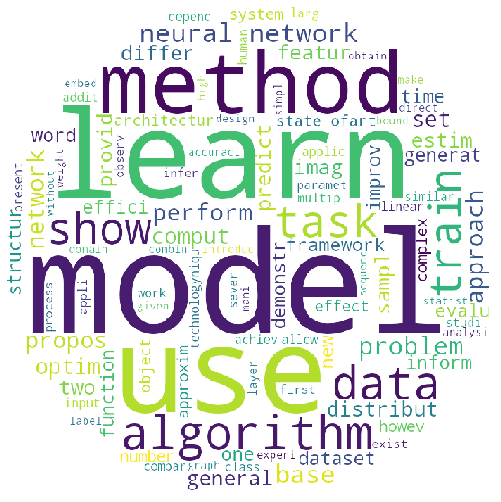
REVIEWS

Slide 20
TITLES
 | Accepted |  | Rejected
1 | learn | 0.0404 | learn | 0.0297
2 | network | 0.0288 | network | 0.0239
3 | neural | 0.0261 | neural | 0.0188
4 | model | 0.0246 | model | 0.0183
5 | optim | 0.0170 | base | 0.0174
6 | neural network | 0.0169 | use | 0.0164
7 | deep | 0.0149 | deep | 0.0143
8 | generate | 0.0113 | neural network | 0.0142
9 | use | 0.0112 | data | 0.0108
10 | base | 0.0111 | machine | 0.0106
Notes:
weight is composed by two terms:
TF: Term Frequency
IDF : Inverse Document Frequency

Slide 21
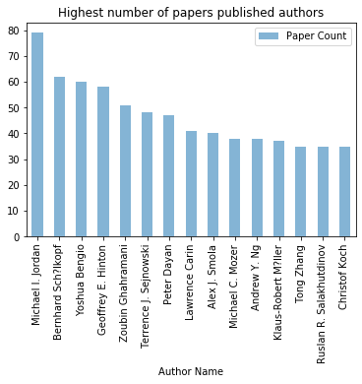
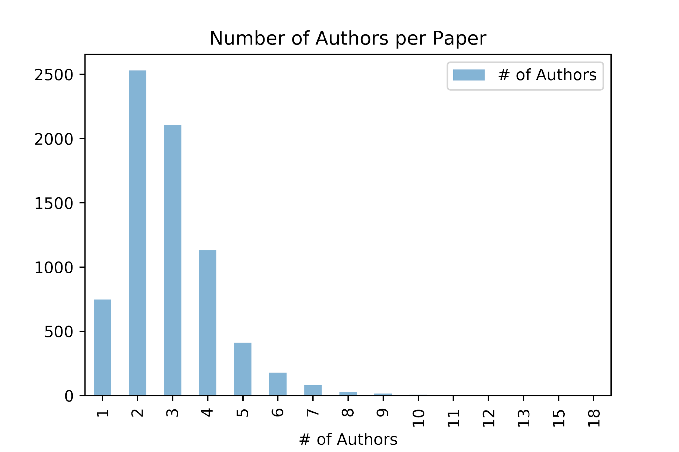
INSIGHTS
FROM
NIPS DATASET

Slide 22
03
APPLICATION
Methodology & Models

Slide 23
OUR METHOD
Content-based Classification
Review-based Classification
Enhancement with Auxiliary Data
ACL 2017
CoNLL 2016
ICLR 2017
NIPS 2014-2016
arXiv 2007-2017
ACL 2017
CoNLL 2016
ICLR 2017
NIPS 2016
ICLR 2017
NIPS 2014-2016
arXiv 2007-2017
+
Google Scholarly

Slide 24
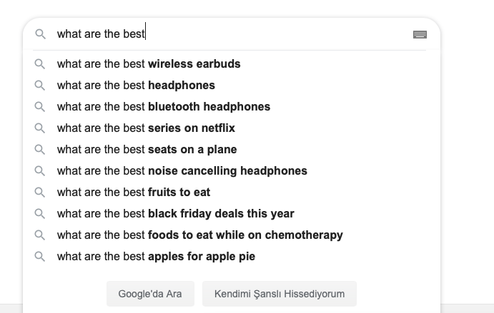
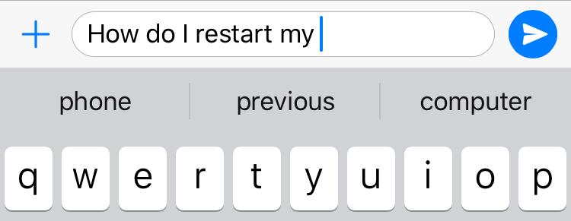
TRANSFER LEARNING
Language Modeling: Predicting the next word conditioned on the current state of a sentence.
Transfer learning: In a text classification model, firstly build a language model to gain knowledge of the language distribution and then continue training the model on your specific classification task.

Slide 25

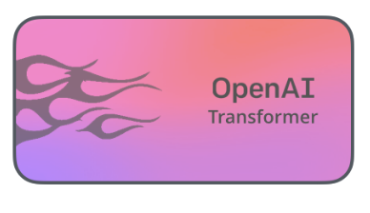


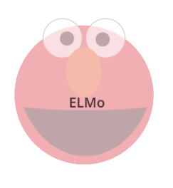
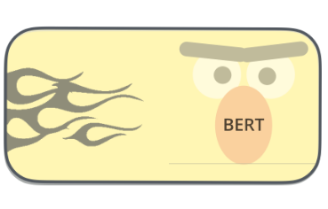

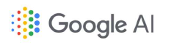
TRANSFER LEARNING IN NLP THROUGH TIME
GPT
GPT2
Feb 18
Oct 18
Jan 18
Jun 18
Feb 19
http://jalammar.github.io/illustrated-bert/

Slide 26

TRANSFER LEARNING IN NLP THROUGH TIME
Feb 18
Oct 18
Jan 18
Jun 18
Feb 19
http://jalammar.github.io/illustrated-bert/

Slide 27


TRANSFER LEARNING IN NLP
ELMo
ULMFit
Trained on a large text corpus
Randomly initialized downstream model
Model: 2-layer biLSTM
Tokens: words
Trained on a large text corpus
Target task LM and classifier fine-tuning
Model: 3-layer AWD LSTM
Tokens: words
Notes:
ULMFiT ensembles the predictions of a forward and backward language model. Even though bidirectionality has been found to be important in contextual word vectors, we did not see big improvements for our downstream tasks (text classification) with ELMo-style joint training. As joint training is quite memory-intensive and we emphasize efficiency, we opted to just train forward language models for all languages.

Slide 28
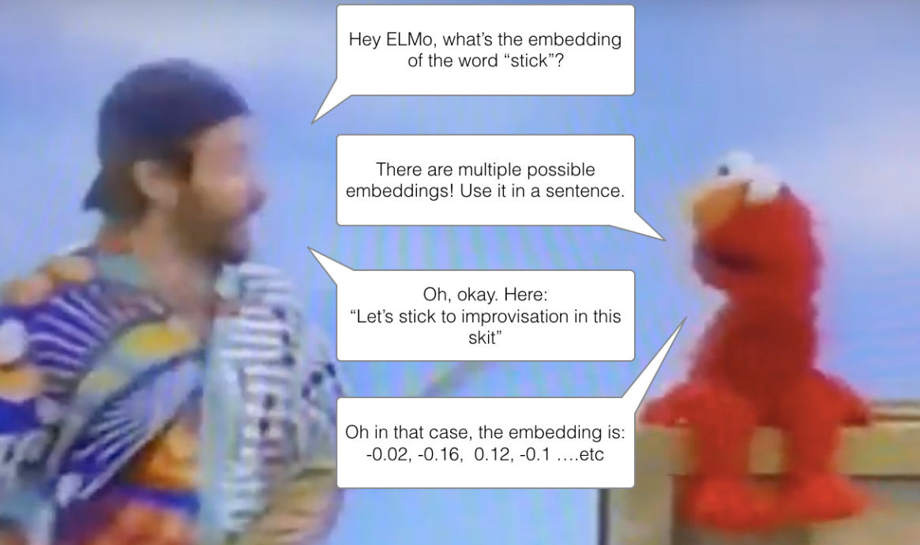
“This is a quote. Words full of wisdom that someone important said and can make the reader get inspired.”
—SOMEONE FAMOUS
http://jalammar.github.io/illustrated-bert/

Slide 29
EMBEDDING FOR LANGUAGE MODELS
1 Billion Word Benchmark
Deep Contextualized Word Representations:
Complex characteristics of word use
How these uses vary across linguistic contexts
A fixed mean-pooled vector representation of the input
Two-layer bidirectional LSTMs
✓
✓
Notes:
Complex characteristics of word use (syntax and semantics)
How these uses vary across linguistic contexts (to model polysemy)
Corporated into wide range of existing NLP architectures
This modules supports inputs both in the form of raw text strings or tokenized text strings.
Semi-supervised learning where the biLM is pre-trained at a large scale
We set the trainable parameter to True when creating the module so that the 4 scalar weights (as described in the paper) can be trained. In this setting, the module still keeps all other parameters fixed.

Slide 30

...
Forward
Layer 2
...
Backward
...
Forward
Layer 1
...
Backward
Notes:
2.The forward pass contains information about a certain word and the context (other words) before that word
2.The backward pass contains information about the word and the context after it

Slide 31
...
Forward
Layer 2
...
Backward
...
Forward
Layer 1
...
Backward
Raw word vectors
---
---
---
...
It
is
ever
Notes:
2. These raw word vectors act as inputs to the first layer of biLM

Slide 32
...
...
Forward
Layer 2
...
Backward
Intermediate word vectors
---
---
---
---
...
---
---
Forward
Layer 1
...
Backward
Raw word vectors
---
---
---
...
It
is
ever
Notes:
3.This pair of information, from the forward and backward pass, forms the intermediate word vectors

Slide 33
Intermediate word vectors
---
---
---
---
...
---
---
...
Forward
Layer 2
...
Backward
Intermediate word vectors
---
---
---
---
...
---
---
Forward
Layer 1
...
Backward
Raw word vectors
---
---
---
...
It
is
ever
Notes:
4.These intermediate word vectors are fed into the next layer of biLM

Slide 34
Intermediate word vectors
---
---
---
---
...
---
---
...
Forward
Layer 2
...
Backward
Intermediate word vectors
---
---
---
---
...
---
---
Forward
Layer 1
...
Backward
Raw word vectors
---
---
---
...
It
is
ever
Notes:
5.The final representation (ELMo) is the weighted sum of the raw word vectors and the 2 intermediate word vectors

Slide 35
PRE-TRAINED ELMO MODELS
Model | #Parameters (Millions) | LSTM Hidden Input Size/ Output Size | SRL F1 | Constituency Parsing F1
Small | 13.6 | 1024/128 | 83.62 | 93.12
Medium | 28.0 | 2048/256 | 84.04 | 93.60
Original | 93.6 | 4096/512 | 84.63 | 93.85
Original (5.5 gb) | 93.6 | 4096/512 | 84.93 | 94.01
Notes:
semantic role labeling is the process that assigns labels to words or phrases in a sentence that indicate their semantic role in the sentence, such as that of an agent, goal, or result.[1]
Semantic role labeling (SRL) systems aim to recover the predicate-argument structure of a sentence, to determine essentially “who did what to
whom”, “when”, and “where.”
Constituency parsing: Phrase structure organizes words into nested constituents. Constituency parsing aims to extract a constituency-based parse tree from a sentence that represents its syntactic structure according to a phrase structure grammar.

Slide 36
Universal Language Model Fine-tuning
Pre-trained on Wikitext-103
AWD LSTM:
Dropconnect
Three layer LSTM
Prevents catastrophic overforgetting
✓
✓
Notes:
Complex characteristics of word use (syntax and semantics)
How these uses vary across linguistic contexts (to model polysemy)
Character based mi??
Corporated into wide range of existing NLP architectures
This modules supports inputs both in the form of raw text strings or tokenized text strings.
Semi-supervised learning where the biLM is pre-trained at a large scale
We set the trainable parameter to True when creating the module so that the 4 scalar weights (as described in the paper) can be trained. In this setting, the module still keeps all other parameters fixed.
Semi-supervised learning where the biLM is pre-trained at a large scale

Slide 37
UNIVERSAL LANGUAGE MODEL FINE TUNING
Language Model
Language Model Learner
Fine Tuning
Fine-tune LM on target data
Classifier
Learn Text Classifier

Slide 38
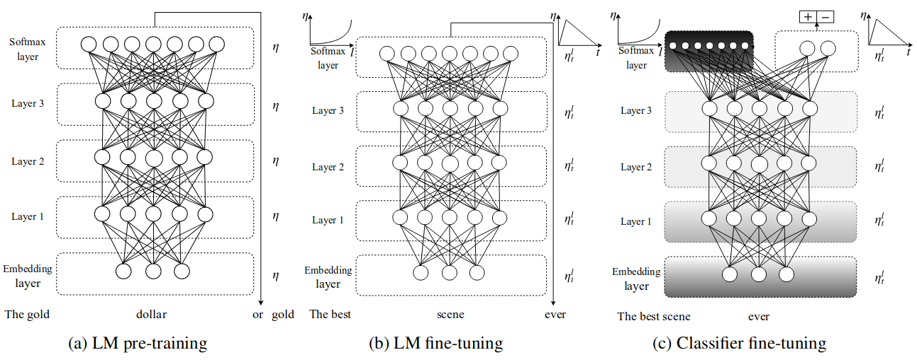
UNIVERSAL LANGUAGE MODEL FINE TUNING
Howard, Jeremy, and Sebastian Ruder. "Universal language model fine-tuning for text classification." arXiv preprint arXiv:1801.06146 (2018).

Slide 39
AVERAGE SGD WEIGHT DROPPED LSTM
Language model is trained with AWD-LSTM
Dropouts were successful, however;
ineffective as it disrupts the RNN’s ability to retain long-term dependencies.
Dropconnect
Embedding size 400
3 Layers
1150 hidden activations per layer
✕
✓
Notes:
d=400 for ulmfit, it was 1024 in elmo.

Slide 40
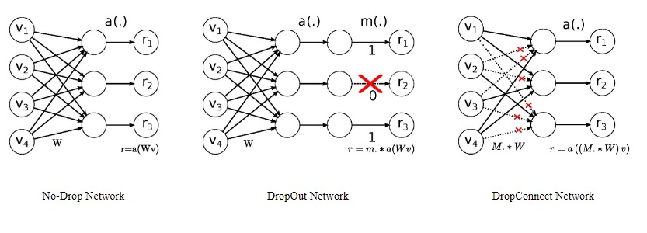
AWD LSTM
Smirnov, Evgeny A., Denis M. Timoshenko, and Serge N. Andrianov. "Comparison of regularization methods for imagenet classification with deep convolutional neural networks." Aasri Procedia 6 (2014): 89-94.
Notes:
Dropout: Randomly selected subset of activations is set to zero
Dropconnect: sets a randomly selected subset of weights within the network to zero.

Slide 41
What’s novel about ULMFit?
Discriminative fine-tuning
Slanted triangular learning rates
Gradual unfreezing

Slide 42
DISCRIMINATIVE FINE TUNING
Different layers to be fine-tuned to different extents
Layer individual learning rate
Golden factor in learning rates: 2.6
Notes:
As different layers capture different types of information (Yosinski et al., 2014), they should be fine-tuned to different extents.
Instead of using the same learning rate for all layers of the model, discriminative fine-tuning allows us to tune each layer with different learning rates.
It was empirically found that first fine-tuning only the last layer (with the others frozen), and then unfreezing all the layers and applying a learning rate lowered by a factor of 2.6 for all other layers during language model fine-tuning worked well in most cases.

Slide 43
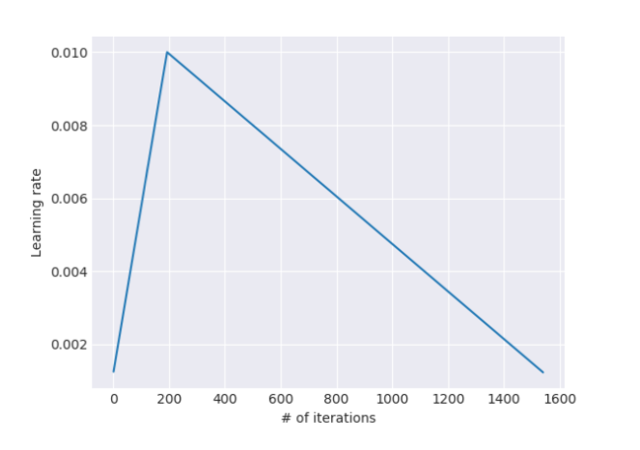
SLANTED TRIANGULAR LEARNING RATES
For adapting its parameters to task-specific features.
Leslie Smith (2017)
First linearly increases the learning rate and then linearly decays
In ULMFit implementation:
1-cycle learning rate policy: allows a larger initial learning rate and decreases it
✓
Howard, Jeremy, and Sebastian Ruder. "Universal language model fine-tuning for text classification." arXiv preprint arXiv:1801.06146 (2018).
Notes:
this doesn’t mean we run it for one epoch — the ‘1’ in 1-cycle means it just cycles the learning rate down one epoch before the max epochs that we specify.

Slide 44
GRADUAL UNFREEZING
Overcome catastrophic forgetting
Gradually unfreeze:
First unfreeze the last layer and fine-tune all unfrozen layers for one epoch.
Then unfreeze the next lower frozen layer and repeat, until all layers are tuned.
✓
✓
Notes:
Rather than fine-tuning all layers at once, which risks catastrophic forgetting, we propose to gradually unfreeze the model starting from the last layer as this contains the least general knowledge

Slide 45
CONCAT POOLING
Information may get lost if we only consider the last hidden state of the model
Concatenate the hidden state at the last time step
With both the max-pooled and the mean-pooled representation of the hidden states over as many time steps as fit in GPU memory
H = {h1,...,hT}:
Notes:
The signal in text classification tasks is often contained in a few words, which may occur anywhere in the document. As input documents can consist of hundreds of words, information may get lost if we only consider the last hidden state of the model. For this reason, we concatenate the hidden state at the last time step hT of the document with both the max-pooled and the mean-pooled representation of the hidden states over as many time steps as fit in GPU memoryH = {h1,...,hT}:
Concat pooling extracts max-polling and mean-pooling over the history of hidden states and concatenates them with the final hidden state

Slide 46
04
RESULTS
Results & Future Research

Slide 47
Content-based Classification

Slide 48
 | ELMo |  | ULMFit |  | Lasso Regression
 | Accuracy | F Score | Accuracy | F Score | Accuracy | F Score
Imbalanced | 0.725 | 0.471 | 0.768 | 0.617 | 0.767 | 0.573
Undersampling | 0.691 | 0.603 | 0.706 | 0.539 | 0.747 | 0.654
Notes:
LASSO (Least Absolute Shrinkage Selector Operator)
Reviews: 74% accepted, 26% rejected
Abstract: 33% accepted, 67% rejected
Precision: TP / (TP + FP) - among the ones that we predict accepted, what % of it was actually accepted?
Recall: TP / (TP+FN) - among the ones that are actually accepted, what % of it we could predict true?
FScore: Harmonic mean of precision and recall. False Negatives and False Positives are crucial.imbalanced class distribution.

Slide 49
Review-based Classification

Slide 50
 | ELMo |  | ULMFit |  | Lasso Regression
 | Accuracy | F Score | Accuracy | F Score | Accuracy | F Score
Imbalanced | 0.743 | 0.851 | 0.744 | 0.853 | 0.737 | 0.849
Undersampling | 0.716 | 0.781 | 0.709 | 0.813 | 0.661 | 0.712

Slide 51
Enhancement with Auxiliary Data

Slide 52


To be continued...

Slide 53
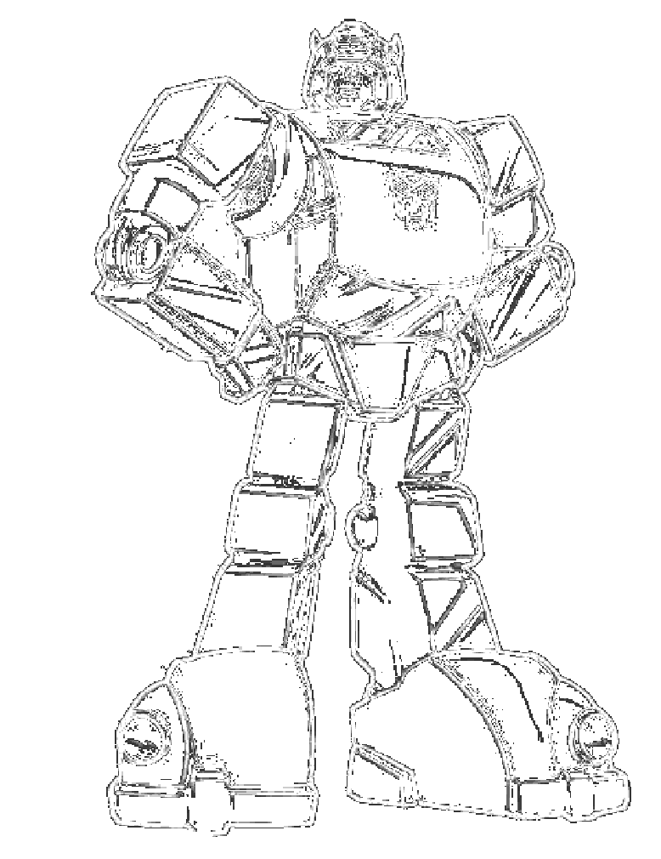
FURTHER RESEARCH
Transparent reviews, more opt-in
Crawling: Extension of ICLR dataset
Classification based on different paper contents
Transformers

Slide 54
THANKS!
Any further questions?
ciloglua@hu-berlin.de
merdanme@hu-berlin.de

